Slide 1
Matching Systems
SAMBO
Falcon
DSSim
RiMOM
ASMOV
Anchor-Flood
AgreementMaker

Slide 2
Matching Methods for Ontologies
Linguistic matching algorithms
- based on syntactic similarity
Structure-based Strategies
- based on syntactic similarity
# concept-to-concept
# property-to-property
# concept-to-property
Graph based techniques
- based on semantic similarity
also, Algorithms based on Machine Learning

Slide 3
SAMBO
Assists in aligning and merging of two ontologies
  - chiefly biomedical ontologies
OWL format
System proposes alignment suggestions
Checks consistency of new(merged) ontology
Reference:-
  Lambrix P, Tan H, `SAMBO - A System for Aligning and Merging Biomedical Ontologies', Journal of Web Semantics
  http://rewerse.net/publications/download/REWERSE-RP-2006-058.pdf

Slide 4
Falcon
Deals with large scale ontologies
3 phases:
  Partitioning ontologies
  Matching blocks
  Discovering Alignments
Open Source
Released under SEALS Platform
Efficiency:- page 11, Shvaiko-Euzenat paper
References:
  http://ws.nju.edu.cn/falcon-ao/index.jsp
  http://www.websemanticsjournal.org/index.php/ps/article/viewFile/146/144

Slide 5
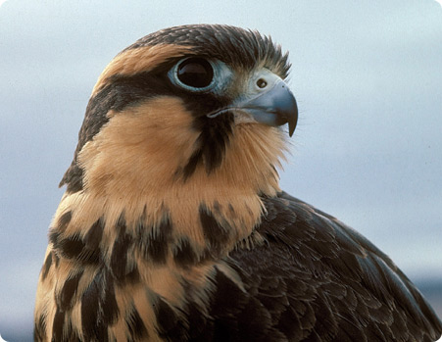
What is Falcon
Finding, Aligning, Learning ontologies, and ultimately for Capturing knowledge by an ONtology-driven approach.
A suit of methods and tools for the Semantic Web applications
Reference:- Southeast University, P. R. China

Slide 6
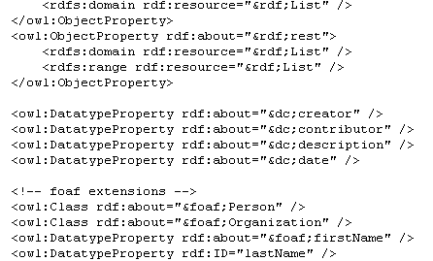

What is Falcon-AO
Aligning Ontologies with Falcon
An integration of two matchers
  LMO – Linguistic Matching for Ontologies
  GMO – Graph Matching for Ontologies
Reference:- Southeast University, P. R. China

Slide 7
Architecture of Falcon-AO
Linguistic Comparability
&
Structural Comparability
Reference:- Southeast University, P. R. China

Slide 8
DSSim
Alternative to the existing Machine-learning approaches
Provides Multi-agent approach, makes use of uncertain reasoning
Improves correctness of ontology mappings
No dedicated GUI - Uses AQUA ontology-based question answering system
Reference:
  DSSim - Managing Uncertainty on the Semantic Web
  http://ceur-ws.org/Vol-304/paper13.pdf
  Springer: Experimental Evaluation of Multi-Agent Ontology Mapping Framework

Slide 9
RiMOM
Risk Minimization based Ontology Mapping
Combines different strategies
Basic matching methods employed: linguistic & sturctural
Finds the optimal alignment results
References:
  RiMOM: A Dynamic Multistrategy Ontology Alignment Framework
  http://ieeexplore.ieee.org/stamp/stamp.jsp?arnumber=04633358
  RiMOM Results for OAEI 2009
  Avaialble for download: http://keg.cs.tsinghua.edu.cn/project/RiMOM/

Slide 10
ASMOV
Automatic Ontology matching with semantic verification
Input: two OWL ontologies + alignment
Output: n:m alignment b/w ontologies
Alignment is checked for inconsistency
References:
  http://disi.unitn.it/~p2p/RelatedWork/Matching/ontology_matching_with_semantic_verification.pdf
  http://www.infotechsoft.com/research/ASMOV%20-%20Ontology%20Alignment%20with%20Semantic%20Validation.pdf

Slide 11
AgreementMaker
Wide range of Ontology and Schema Matchers
Syntactic
Structural
Instance
GUI: SEALS Interface, and at http://agreementmaker.org/
Good for XML, OWL, RDFS
OAEI 2010 Results
  Precision: 91.3%
  Recall: 83.6%

Slide 12
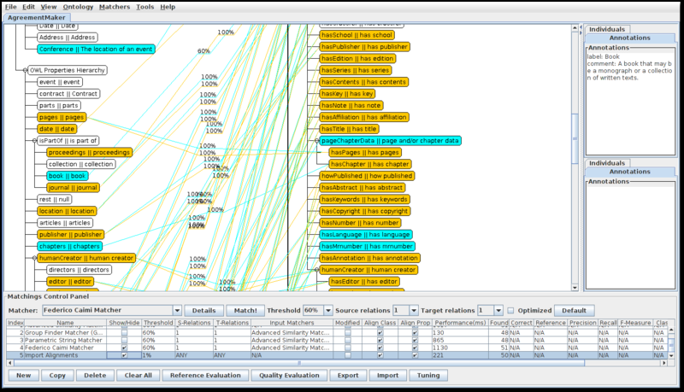
AgreementMaker cond...
Main view of AgreementMaker, visualizing two alignments.

